Slide 1
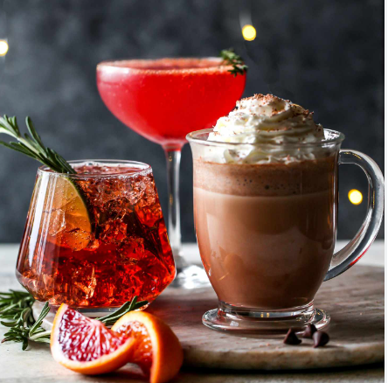
CHOOSE YOUR HOLIDAY ELIXIR
Thursday, December 20, between 6:00 pm – 7:15 pm
Signature Cocktail Recipes
Brought to you by:
ATD LI Festive-Tea Delight:
(A take on the Classic Long Island Ice Tea)
Ingredients:
1 oz Cranberry juice
1 oz orange juice
1 oz pineapple juice
1 oz sweetened iced tea
½ oz grenadine syrup
1 ½ oz vodka or white rum (optional for cocktail version)
Ice cubes
Orange slices, cranberries, and mint for garnish
Instructions:
In a cocktail shaker, combine cranberry juice, orange juice, pineapple juice, sweetened iced tea, and grenadine syrup.
If preparing a cocktail, add 1 ½ oz of vodka or white rum to the shaker.
Shake the mixture well to infuse the flavors.
Fill a tall glass with ice cubes.
Pour the delightful concoction over the ice, allowing the vibrant colors to cascade.
Garnish with orange slices, floating cranberries, and a sprig of mint for that extra festive touch.
ATD LI Sparkling Winter Punch:
Ingredients:
1 Cup Cranberry Juice
1/2 Cup Apple Cider
1/4 cup orange juice
1 Tablespoon Honey
1 Cup Sparkling Water or champagne (For the Cocktail Version)
Ice cubes
Sliced apples and cranberries for garnish
Instructions:
In a pitcher, mix cranberry juice, apple cider, orange juice, and honey.
Stir well to blend the flavors.
For the cocktail version, add sparkling water or champagne to the pitcher.
Place ice cubes in glasses.
Pour the punch over the ice.
Garnish with sliced apples and floating cranberries for a festive look
ATD LI Holiday Sparkle Spritzer:
Ingredients:
1 Cup Cranberry Juice
½ Cup Sparkling Water
Freshly squeezed juice of half a lime
Ice cubes
Lime wedges for garnish
Instructions:
Fill a glass with ice cubes.
Pour cranberry juice over the ice.
Add sparkling water for a bubbly lift.
Squeeze the juice of half a lime into the mix.
Give it a gentle stir to blend the flavors.
Garnish with lime wedges for that extra citrus kick.

